Slide 1
Appendix H – Elevator Model
Outline
H.1 Introduction
H.2 Class ElevatorModel
H.3 Classes Location and Floor
H.4 Class Door
H.5 Class Button
H.6 Class ElevatorShaft
H.7 Classes Light and Bell
H.8 Class Elevator
H.9 Class Person
H.10 Component Diagrams Revisited

Slide 2
H.1 Introduction
Elevator model
  Contains data for elevator-simulation case study
  Represented via 10 classes
    ElevatorModel
    Location
    Floor
    Door
    Button
    ElevatorShaft
    Light
    Bell
    Elevator
    Person

Slide 3
H.2 Class ElevatorModel
ElevatorModel
  “Ties together” the objects that comprise the elevator model
  Sends events from model to view
  Instantiates Person object (as per user request)

Slide 4
Fig. H.1 Class ElevatorModel represents the model in our elevator simulation.
Line 12
Lines 16-20
Lines 23-28
Line 31
1 // ElevatorModel.java
2 // Elevator simulation model with ElevatorShaft and two Floors
3 package com.deitel.jhtp4.elevator.model;
4
5 // Java core packages
6 import java.util.*;
7
8 // Deitel packages
9 import com.deitel.jhtp4.elevator.event.*;
10 import com.deitel.jhtp4.elevator.ElevatorConstants;
11
12 public class ElevatorModel implements ElevatorModelListener,
13 ElevatorConstants {
14
15 // declare two-Floor architecture in simulation
16 private Floor firstFloor;
17 private Floor secondFloor;
18
19 // ElevatorShaft in simulation
20 private ElevatorShaft elevatorShaft;
21
22 // objects listening for events from ElevatorModel
23 private Set personMoveListeners;
24 private DoorListener doorListener;
25 private ButtonListener buttonListener;
26 private LightListener lightListener;
27 private BellListener bellListener;
28 private ElevatorMoveListener elevatorMoveListener;
29
30 // cumulative number of people in simulation
31 private int numberOfPeople = 0;
32
ElevatorModel implements ElevatorModelListener, which inherits from all listener interfaces
Use class diagram to determine associations with Floor and ElevatorShaft
Declare listeners that receive events from model (and will send these events to ElevatorView)
Use class diagram to determine attributes

Slide 5
Fig. H.1 Class ElevatorModel represents the model in our elevator simulation (Part 2).
Lines 37-46
Lines 49-53
Line 61-72
33 // constructor instantiates ElevatorShaft and Floors
34 public ElevatorModel()
35 {
36 // instantiate firstFloor and secondFloor objects
37 firstFloor = new Floor( FIRST_FLOOR_NAME );
38 secondFloor = new Floor( SECOND_FLOOR_NAME );
39
40 // instantiate ElevatorShaft object
41 elevatorShaft =
42 new ElevatorShaft( firstFloor, secondFloor );
43
44 // give elevatorShaft reference to first and second Floor
45 firstFloor.setElevatorShaft( elevatorShaft );
46 secondFloor.setElevatorShaft( elevatorShaft );
47
48 // register for events from ElevatorShaft
49 elevatorShaft.setDoorListener( this );
50 elevatorShaft.setButtonListener( this );
51 elevatorShaft.addElevatorMoveListener( this );
52 elevatorShaft.setLightListener( this );
53 elevatorShaft.setBellListener( this );
54
55 // instantiate Set for ElevatorMoveListener objects
56 personMoveListeners = new HashSet( 1 );
57
58 } // end ElevatorModel constructor
59
60 // return Floor with given name
61 private Floor getFloor( String name )
62 {
63 if ( name.equals( FIRST_FLOOR_NAME ) )
64 return firstFloor;
65 else
66
Instantiate Floors and ElevatorShaft, then assign the ElevatorShaft reference to each Floor
Register ElevatorModel for events from ElevatorShaft
Accessor method to obtain specified Floor reference

Slide 6
Fig. H.1 Class ElevatorModel represents the model in our elevator simulation (Part 3).
Lines 75-91
Lines 78-86
Lines 94-98
67 if ( name.equals( SECOND_FLOOR_NAME ) )
68 return secondFloor;
69 else
70 return null;
71
72 } // end method getFloor
73
74 // add Person to Elevator Simulator
75 public void placePersonOnFloor( String floorName )
76 {
77 // instantiate new Person and place on Floor
78 Person person =
79 new Person( numberOfPeople, getFloor( floorName ) );
80 person.setName( Integer.toString( numberOfPeople ) );
81
82 // register listener for Person events
83 person.setPersonMoveListener( this );
84
85 // start Person thread
86 person.start();
87
88 // increment number of Person objects in simulation
89 numberOfPeople++;
90
91 } // end method placePersonOnFloor
92
93 // invoked when Elevator has departed from Floor
94 public void elevatorDeparted(
95 ElevatorMoveEvent moveEvent )
96 {
97 elevatorMoveListener.elevatorDeparted( moveEvent );
98 }
99
Method for adding Person to simulation model
Instantiate Person, register ElevatorModel to receive events from that Person and start Person’s thread
When Elevator has departed from Floor, notify listener (i.e., Elevator-View, in this simulation)

Slide 7
Fig. H.1 Class ElevatorModel represents the model in our elevator simulation (Part 4).
Lines 101-105
Lines 108-155
100 // invoked when Elevator has arrived at destination Floor
101 public void elevatorArrived(
102 ElevatorMoveEvent moveEvent )
103 {
104 elevatorMoveListener.elevatorArrived( moveEvent );
105 }
106
107 // send PersonMoveEvent to listener, depending on event type
108 private void sendPersonMoveEvent(
109 int eventType, PersonMoveEvent event )
110 {
111 Iterator iterator = personMoveListeners.iterator();
112
113 while ( iterator.hasNext() ) {
114
115 PersonMoveListener listener =
116 ( PersonMoveListener ) iterator.next();
117
118 // send Event to this listener, depending on eventType
119 switch ( eventType ) {
120
121 // Person has been created
122 case Person.PERSON_CREATED:
123 listener.personCreated( event );
124 break;
125
126 // Person arrived at Elevator
127 case Person.PERSON_ARRIVED:
128 listener.personArrived( event );
129 break;
130
131 // Person entered Elevator
132 case Person.PERSON_ENTERING_ELEVATOR:
133 listener.personEntered( event );
134 break;
When Elevator has arrived at Floor, notify listener (ElevatorView)
When Person performs some action (event) in model, determine which event was sent, then forward the event to any listeners

Slide 8
Fig. H.1 Class ElevatorModel represents the model in our elevator simulation (Part 5).
Lines 108-155
Lines 158-161
Lines 164-167
135
136 // Person pressed Button object
137 case Person.PERSON_PRESSING_BUTTON:
138 listener.personPressedButton( event );
139 break;
140
141 // Person exited Elevator
142 case Person.PERSON_EXITING_ELEVATOR:
143 listener.personDeparted( event );
144 break;
145
146 // Person exited simulation
147 case Person.PERSON_EXITED:
148 listener.personExited( event );
149 break;
150
151 default:
152 break;
153 }
154 }
155 } // end method sendPersonMoveEvent
156
157 // invoked when Person has been created in model
158 public void personCreated( PersonMoveEvent moveEvent )
159 {
160 sendPersonMoveEvent( Person.PERSON_CREATED, moveEvent );
161 }
162
163 // invoked when Person has arrived at Floor's Button
164 public void personArrived( PersonMoveEvent moveEvent )
165 {
166 sendPersonMoveEvent( Person.PERSON_ARRIVED, moveEvent );
167 }
168
When Person performs some action (event) in model, determine which event was sent, then forward the event to any listeners
When Person has been created, notify listeners
When Person has arrived at Elevator, notify listeners

Slide 9
Fig. H.1 Class ElevatorModel represents the model in our elevator simulation (Part 6).
Lines 170-174
Lines 177-181
Lines 184-188
Lines 191-194
Lines 197-200
169 // invoked when Person has pressed Button
170 public void personPressedButton( PersonMoveEvent moveEvent )
171 {
172 sendPersonMoveEvent( Person.PERSON_PRESSING_BUTTON,
173 moveEvent );
174 }
175
176 // invoked when Person has entered Elevator
177 public void personEntered( PersonMoveEvent moveEvent )
178 {
179 sendPersonMoveEvent( Person.PERSON_ENTERING_ELEVATOR,
180 moveEvent );
181 }
182
183 // invoked when Person has departed from Elevator
184 public void personDeparted( PersonMoveEvent moveEvent )
185 {
186 sendPersonMoveEvent( Person.PERSON_EXITING_ELEVATOR,
187 moveEvent );
188 }
189
190 // invoked when Person has exited Simulation
191 public void personExited( PersonMoveEvent moveEvent )
192 {
193 sendPersonMoveEvent( Person.PERSON_EXITED, moveEvent );
194 }
195
196 // invoked when Door has opened
197 public void doorOpened( DoorEvent doorEvent )
198 {
199 doorListener.doorOpened( doorEvent );
200 }
201
When Person has pressed Button, notify listeners
When Person has entered Elevator, notify listeners
When Person has left Elevator, notify listeners
When Person has exited simulation, notify listeners
When Door has opened, notify listeners

Slide 10
Fig. H.1 Class ElevatorModel represents the model in our elevator simulation (Part 7).
Lines 203-206
Lines 209-212
Lines 215-218
Lines 221-224
Lines 227-230
Lines 233-236
202 // invoked when Door has closed
203 public void doorClosed( DoorEvent doorEvent )
204 {
205 doorListener.doorClosed( doorEvent );
206 }
207
208 // invoked when Button has been pressed
209 public void buttonPressed( ButtonEvent buttonEvent )
210 {
211 buttonListener.buttonPressed( buttonEvent );
212 }
213
214 // invoked when Button has been reset
215 public void buttonReset( ButtonEvent buttonEvent )
216 {
217 buttonListener.buttonReset( buttonEvent );
218 }
219
220 // invoked when Bell has rung
221 public void bellRang( BellEvent bellEvent )
222 {
223 bellListener.bellRang( bellEvent );
224 }
225
226 // invoked when Light has turned on
227 public void lightTurnedOn( LightEvent lightEvent )
228 {
229 lightListener.lightTurnedOn( lightEvent );
230 }
231
232 // invoked when Light has turned off
233 public void lightTurnedOff( LightEvent lightEvent )
234 {
235 lightListener.lightTurnedOff( lightEvent );
236 }
When Door has closed, notify listeners
When Button has been pressed, notify listeners
When Button has been reset, notify listeners
When Bell has rung, notify listeners
When Light has been turned on, notify listeners
When Light has been turned off, notify listeners

Slide 11
Fig. H.1 Class ElevatorModel represents the model in our elevator simulation (Part 8).
Lines 239-249
Lines 252-256
Lines 259-262
Lines 265-268
237
238 // set listener for ElevatorModelListener
239 public void setElevatorModelListener(
240 ElevatorModelListener listener )
241 {
242 // ElevatorModelListener extends all interfaces below
243 addPersonMoveListener( listener );
244 setElevatorMoveListener( listener );
245 setDoorListener( listener );
246 setButtonListener( listener );
247 setLightListener( listener );
248 setBellListener( listener );
249 }
250
251 // set listener for PersonMoveEvents
252 public void addPersonMoveListener(
253 PersonMoveListener listener )
254 {
255 personMoveListeners.add( listener );
256 }
257
258 // set listener for DoorEvents
259 public void setDoorListener( DoorListener listener )
260 {
261 doorListener = listener;
262 }
263
264 // set listener for ButtonEvents
265 public void setButtonListener( ButtonListener listener )
266 {
267 buttonListener = listener;
268 }
269
Allow ElevatorModelListener to listen for all events from model
Allow PersonListener to listen for PersonMoveEvents from model
Allow DoorListener to listen for DoorEvents from model
Allow ButtonListener to listen for ButtonEvents from model

Slide 12
Fig. H.1 Class ElevatorModel represents the model in our elevator simulation (Part 9).
Lines 271-275
Lines 278-281
Lines 284-287
270 // add listener for ElevatorMoveEvents
271 public void setElevatorMoveListener(
272 ElevatorMoveListener listener )
273 {
274 elevatorMoveListener = listener;
275 }
276
277 // set listener for LightEvents
278 public void setLightListener( LightListener listener )
279 {
280 lightListener = listener;
281 }
282
283 // set listener for BellEvents
284 public void setBellListener( BellListener listener )
285 {
286 bellListener = listener;
287 }
288 }
Allow ElevatorMoveListener to listen for ElevatorMoveEvents from model
Allow LightListener to listen for LightEvents from model
Allow BellListener to listen for BellEvents from model

Slide 13
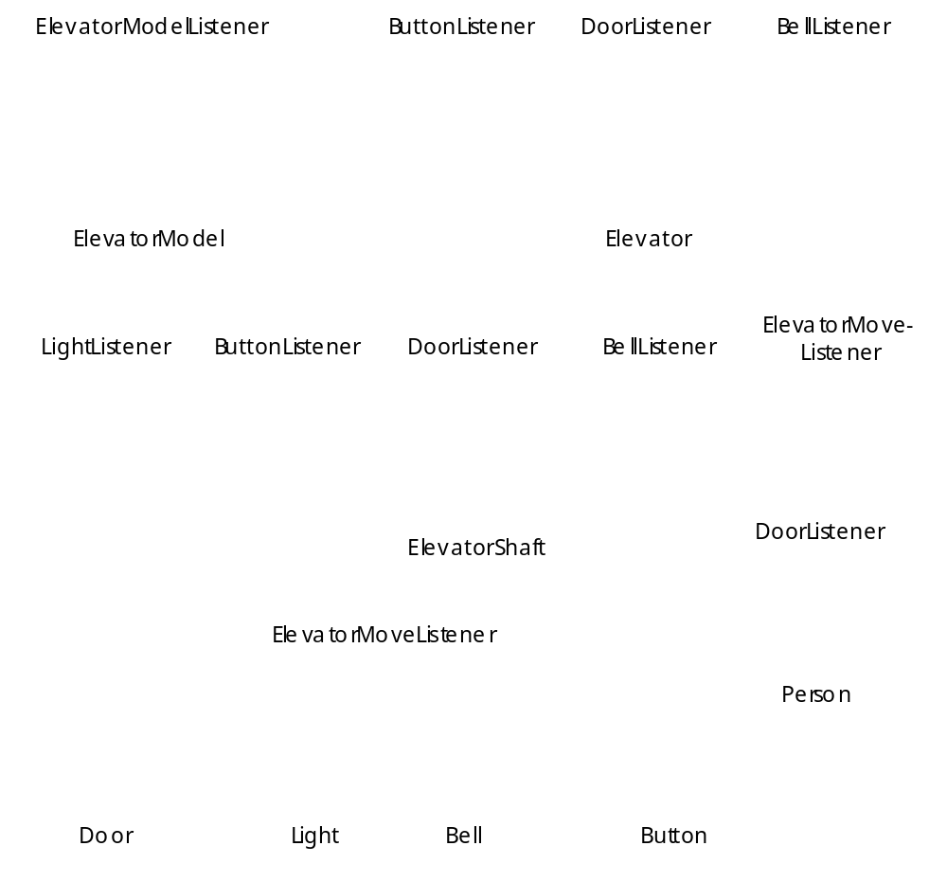
Fig. H.2 Class diagram showing realizations in the elevator model (Part 1/2).

Slide 14
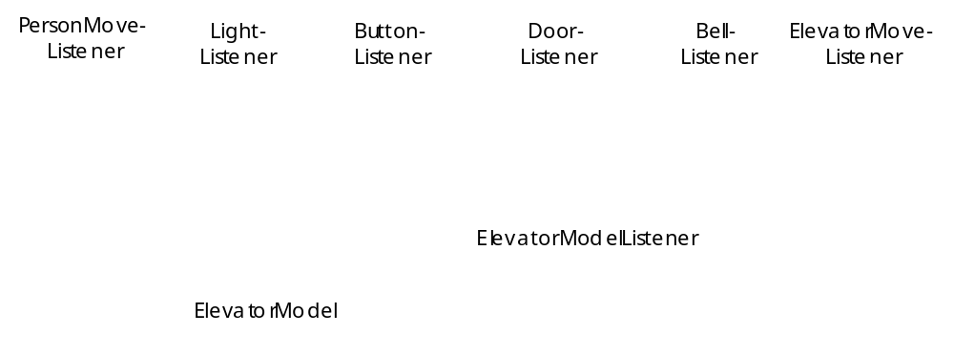
Fig. H.3 Class diagram showing realizations in the elevator model (Part 2/2).

Slide 15
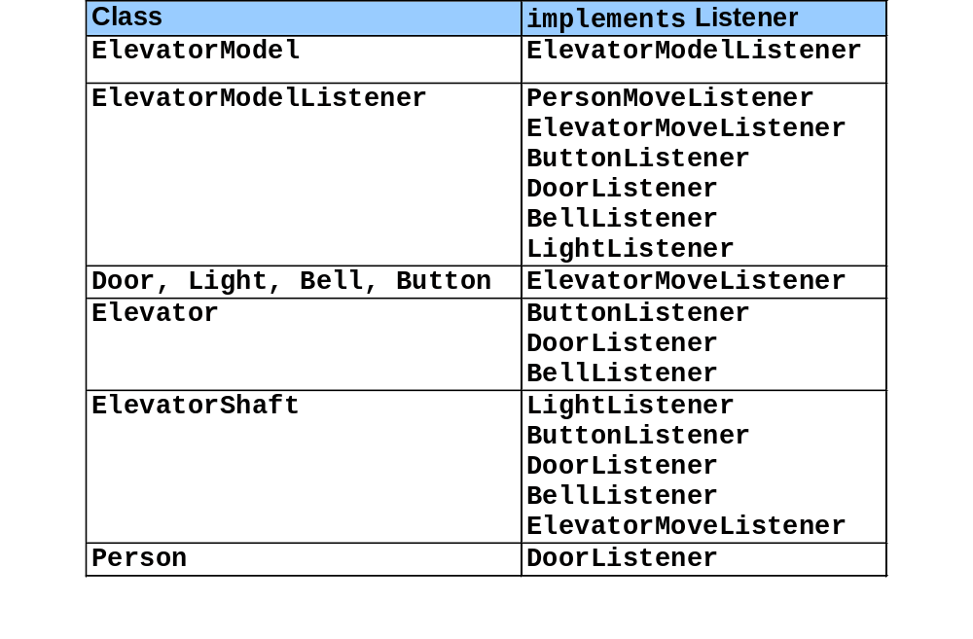
Fig. H.4 Classes and implemented listener interfaces from Fig. H.2.

Slide 16
H.3 Classes Location and Floor
Location
  Represents location in model
    Person has reference to Location
      We can know each Person’s whereabouts
  Abstract base class
  Derived classes: Floor and Elevator
    Floor represents first or second floor in model
    (Elevator is discussed later)

Slide 17
Fig. H.5 Location abstract superclass that represents a location in the simulation.
Line 11
Lines 26-29
1 // Location.java
2 // Abstract superclass representing location in simulation
3 package com.deitel.jhtp4.elevator.model;
4
5 // Deitel packages
6 import com.deitel.jhtp4.elevator.event.*;
7
8 public abstract class Location {
9
10 // name of Location
11 private String locationName;
12
13 // set name of Location
14 protected void setLocationName( String name )
15 {
16 locationName = name;
17 }
18
19 // return name of Location
20 public String getLocationName()
21 {
22 return locationName;
23 }
24
25 // return Button at Location
26 public abstract Button getButton();
27
28 // return Door object at Location
29 public abstract Door getDoor();
30 }
Name of Location can equal “elevator,” “first floor” or second floor”
Classes Floor and Elevator implement these abstract methods to return appropriate objects

Slide 18
Fig. H.6 Class Floor—a subclass of Location—represents a Floor across which a Person walks to the Elevator.
Lines 21-33
1 // Floor.java
2 // Represents a Floor located next to an ElevatorShaft
3 package com.deitel.jhtp4.elevator.model;
4
5 // Deitel packages
6 import com.deitel.jhtp4.elevator.ElevatorConstants;
7
8 public class Floor extends Location
9 implements ElevatorConstants {
10
11 // reference to ElevatorShaft object
12 private ElevatorShaft elevatorShaft;
13
14 // Floor constructor sets name of Floor
15 public Floor( String name )
16 {
17 setLocationName( name );
18 }
19
20 // get first or second Floor Button, using Location name
21 public Button getButton()
22 {
23 if ( getLocationName().equals( FIRST_FLOOR_NAME ) )
24 return getElevatorShaft().getFirstFloorButton();
25 else
26
27 if ( getLocationName().equals( SECOND_FLOOR_NAME ) )
28 return getElevatorShaft().getSecondFloorButton();
29 else
30
31 return null;
32
33 } // end method getButton
34
Implement Location’s abstract method getButton to return Button on either first or second Floor

Slide 19
Fig. H.6 Class Floor—a subclass of Location—represents a Floor across which a Person walks to the Elevator (Part 2).
Lines 36-48
35 // get first or second Floor Door, using Location name
36 public Door getDoor()
37 {
38 if ( getLocationName().equals( FIRST_FLOOR_NAME ) )
39 return getElevatorShaft().getFirstFloorDoor();
40 else
41
42 if ( getLocationName().equals( SECOND_FLOOR_NAME ) )
43 return getElevatorShaft().getSecondFloorDoor();
44 else
45
46 return null;
47
48 } // end method getDoor
49
50 // get ElevatorShaft reference
51 public ElevatorShaft getElevatorShaft()
52 {
53 return elevatorShaft;
54 }
55
56 // set ElevatorShaft reference
57 public void setElevatorShaft( ElevatorShaft shaft )
58 {
59 elevatorShaft = shaft;
60 }
61 }
Implement Location’s abstract method getDoor to return Door on either first or second Floor

Slide 20
H.4 Class Door
Door
  Signals Person when to enter and exit Elevator

Slide 21
Fig. H.7 Class Door, which represents a Door in the model, informs listeners when a Door has opened or closed.
Line 11
Lines 20 and 28
1 // Door.java
2 // Sends DoorEvents to DoorListeners when opened or closed
3 package com.deitel.jhtp4.elevator.model;
4
5 // Java core packages
6 import java.util.*;
7
8 // Deitel packages
9 import com.deitel.jhtp4.elevator.event.*;
10
11 public class Door implements ElevatorMoveListener {
12
13 // represent whether Door is open or closed
14 private boolean doorOpen = false;
15
16 // time before Door closes automatically
17 public static final int AUTOMATIC_CLOSE_DELAY = 3000;
18
19 // Set of DoorListeners
20 private Set doorListeners;
21
22 // location where Door opened or closed
23 private Location doorLocation;
24
25 // Door constructor instantiates Set for DoorListeners
26 public Door()
27 {
28 doorListeners = new HashSet( 1 );
29 }
30
Door listens for ElevatorMoveEvents; when Elevator arrives, Door opens
HashSet stores listener for DoorEvents (i.e., when Door opens and closes)

Slide 22
Fig. H.7 Class Door, which represents a Door in the model, informs listeners when a Door has opened or closed (Part 2).
Lines 32-49
Line 56
31 // add Door listener
32 public void addDoorListener( DoorListener listener )
33 {
34 // prevent other objects from modifying doorListeners
35 synchronized( doorListeners )
36 {
37 doorListeners.add( listener );
38 }
39 }
40
41 // remove Door listener
42 public void removeDoorListener( DoorListener listener )
43 {
44 // prevent other objects from modifying doorListeners
45 synchronized( doorListeners )
46 {
47 doorListeners.remove( listener );
48 }
49 }
50
51 // open Door and send all listeners DoorEvent objects
52 public void openDoor( Location location )
53 {
54 if ( !doorOpen ) {
55
56 doorOpen = true;
57
58 // obtain iterator from Set
59 Iterator iterator;
60 synchronized( doorListeners )
61 {
62 iterator = new HashSet( doorListeners ).iterator();
63 }
Allow DoorListeners to register and unregister to receive DoorEvents
Open Door if it is closed

Slide 23
Fig. H.7 Class Door, which represents a Door in the model, informs listeners when a Door has opened or closed (Part 3).
Lines 66-73
Lines 78-95
64
65 // get next DoorListener
66 while ( iterator.hasNext() ) {
67 DoorListener doorListener =
68 ( DoorListener ) iterator.next();
69
70 // send doorOpened event to this DoorListener
71 doorListener.doorOpened(
72 new DoorEvent( this, location ) );
73 }
74
75 doorLocation = location;
76
77 // declare Thread that ensures automatic Door closing
78 Thread closeThread = new Thread(
79 new Runnable() {
80
81 public void run()
82 {
83 // close Door if open for more than 3 seconds
84 try {
85 Thread.sleep( AUTOMATIC_CLOSE_DELAY );
86 closeDoor( doorLocation );
87 }
88
89 // handle exception if interrupted
90 catch ( InterruptedException exception ) {
91 exception.printStackTrace();
92 }
93 }
94 } // end anonymous inner class
95 );
96
Notify DoorListeners that Door has opened
Use Thread to enable Door to close itself automatically after three seconds

Slide 24
Fig. H.7 Class Door, which represents a Door in the model, informs listeners when a Door has opened or closed (Part 4).
Line 106
Lines 116-123
97 closeThread.start();
98 }
99 } // end method openDoor
100
101 // close Door and send all listeners DoorEvent objects
102 public void closeDoor( Location location )
103 {
104 if ( doorOpen ) {
105
106 doorOpen = false;
107
108 // obtain iterator from Set
109 Iterator iterator;
110 synchronized( doorListeners )
111 {
112 iterator = new HashSet( doorListeners ).iterator();
113 }
114
115 // get next DoorListener
116 while ( iterator.hasNext() ) {
117 DoorListener doorListener =
118 ( DoorListener ) iterator.next();
119
120 // send doorClosed event to this DoorListener
121 doorListener.doorClosed(
122 new DoorEvent( this, location ) );
123 }
124 }
125 } // end method closeDoor
126
127 // return whether Door is open or closed
128 public boolean isDoorOpen()
129 {
130 return doorOpen;
131 }
Close Door if it is open
Notify DoorListeners that Door has closed

Slide 25
Fig. H.7 Class Door, which represents a Door in the model, informs listeners when a Door has opened or closed (Part 5).
Lines 137-140
132
133 // invoked after Elevator has departed
134 public void elevatorDeparted( ElevatorMoveEvent moveEvent ) {}
135
136 // invoked when Elevator has arrived
137 public void elevatorArrived( ElevatorMoveEvent moveEvent )
138 {
139 openDoor( moveEvent.getLocation() );
140 }
141 }
When Elevator arrives, open Door

Slide 26
H.5 Class Button
Button
  Signals Elevator to move between Floors

Slide 27
Fig. H.8 Class Button, which represents a Button in the model, informs listeners when a Button has been pressed or reset.
Line 8
Lines 11 and 17-20
Lines 23-29
1 // Button.java
2 // Sends ButtonEvents to ButtonListeners when accessed
3 package com.deitel.jhtp4.elevator.model;
4
5 // Deitel packages
6 import com.deitel.jhtp4.elevator.event.*;
7
8 public class Button implements ElevatorMoveListener {
9
10 // ButtonListener
11 private ButtonListener buttonListener = null;
12
13 // represent whether Button is pressed
14 private boolean buttonPressed = false;
15
16 // set listener
17 public void setButtonListener( ButtonListener listener )
18 {
19 buttonListener = listener;
20 }
21
22 // press Button and send ButtonEvent
23 public void pressButton( Location location )
24 {
25 buttonPressed = true;
26
27 buttonListener.buttonPressed(
28 new ButtonEvent( this, location ) );
29 }
30
31 // reset Button and send ButtonEvent
32 public void resetButton( Location location )
33 {
34 buttonPressed = false;
Button listens for ElevatorMoveEvents; when Elevator arrives, Button resets
Allow ButtonListener to listen for ButtonEvents
Press Button and notify ButtonListener that Button has been pressed

Slide 28
Fig. H.8 Class Button, which represents a Button in the model, informs listeners when a Button has been pressed or reset (Part 2).
Lines 32-38
Lines 50-53
35
36 buttonListener.buttonReset(
37 new ButtonEvent( this, location ) );
38 }
39
40 // return whether button is pressed
41 public boolean isButtonPressed()
42 {
43 return buttonPressed;
44 }
45
46 // invoked when Elevator has departed
47 public void elevatorDeparted( ElevatorMoveEvent moveEvent ) {}
48
49 // invoked when Elevator has arrived
50 public void elevatorArrived( ElevatorMoveEvent moveEvent )
51 {
52 resetButton( moveEvent.getLocation() );
53 }
54 }
Reset Button and notify ButtonListener that Button has been reset
When Elevator arrives, reset Button

Slide 29
H.6 Class ElevatorShaft
ElevatorShaft
  Represents elevator shaft in which Elevator travels
  Receives events from Elevator
  “Bubbles up” events to ElevatorModel

Slide 30
Fig. H.9 Class ElevatorShaft, which represents the Elevator-Shaft, which sends events from the Elevator to the ElevatorModel.
Lines 11-12
Lines 18-27
Lines 30-34
1 // ElevatorShaft.java
2 // Represents elevator shaft, which contains elevator
3 package com.deitel.jhtp4.elevator.model;
4
5 // Java core packages
6 import java.util.*;
7
8 // Deitel packages
9 import com.deitel.jhtp4.elevator.event.*;
10
11 public class ElevatorShaft implements ElevatorMoveListener,
12 LightListener, BellListener {
13
14 // Elevator
15 private Elevator elevator;
16
17 // Buttons on Floors
18 private Button firstFloorButton;
19 private Button secondFloorButton;
20
21 // Doors on Floors
22 private Door firstFloorDoor;
23 private Door secondFloorDoor;
24
25 // Lights on Floors
26 private Light firstFloorLight;
27 private Light secondFloorLight;
28
29 // listeners
30 private DoorListener doorListener;
31 private ButtonListener buttonListener;
32 private LightListener lightListener;
33 private BellListener bellListener;
34 private Set elevatorMoveListeners;
35
ElevatorShaft listens for ElevatorMoveEvents LightEvents and BellEvents
Use class diagram to determine associations of ElevatorShaft
Declare listeners that receive events from model (and will send these events to ElevatorModel)

Slide 31
Fig. H.9 Class ElevatorShaft, which represents the Elevator-Shaft, which sends events from the Elevator to the ElevatorModel (Part 2).
Lines 43-70
Lines 47-53
Lines 56-59
36 // constructor initializes aggregated components
37 public ElevatorShaft( Floor firstFloor, Floor secondFloor )
38 {
39 // instantiate Set for ElevatorMoveListeners
40 elevatorMoveListeners = new HashSet( 1 );
41
42 // anonymous inner class listens for ButtonEvents
43 ButtonListener floorButtonListener =
44 new ButtonListener() {
45
46 // called when Floor Button has been pressed
47 public void buttonPressed( ButtonEvent buttonEvent )
48 {
49 // request elevator move to location
50 Location location = buttonEvent.getLocation();
51 buttonListener.buttonPressed( buttonEvent );
52 elevator.requestElevator( location );
53 }
54
55 // called when Floor Button has been reset
56 public void buttonReset( ButtonEvent buttonEvent )
57 {
58 buttonListener.buttonReset( buttonEvent );
59 }
60 }; // end anonymous inner class
61
62 // instantiate Floor Buttons
63 firstFloorButton = new Button();
64 secondFloorButton = new Button();
65
66 // register anonymous ButtonListener with Floor Buttons
67 firstFloorButton.setButtonListener(
68 floorButtonListener );
69 secondFloorButton.setButtonListener(
70 floorButtonListener );
Instantiate anonymous inner class to listen for ButtonEvents from Buttons on floors
When Button on floor is pressed, request Elevator to move to Floor of request
When Button on floor is reset, reset Button

Slide 32
Fig. H.9 Class ElevatorShaft, which represents the Elevator-Shaft, which sends events from the Elevator to the ElevatorModel (Part 3).
Lines 77-100
Lines 80-91
Lines 103-105
71
72 // Floor Buttons listen for ElevatorMoveEvents
73 addElevatorMoveListener( firstFloorButton );
74 addElevatorMoveListener( secondFloorButton );
75
76 // anonymous inner class listens for DoorEvents
77 DoorListener floorDoorListener = new DoorListener() {
78
79 // called when Floor Door has opened
80 public void doorOpened( DoorEvent doorEvent )
81 {
82 // forward event to doorListener
83 doorListener.doorOpened( doorEvent );
84 }
85
86 // called when Floor Door has closed
87 public void doorClosed( DoorEvent doorEvent )
88 {
89 // forward event to doorListener
90 doorListener.doorClosed( doorEvent );
91 }
92 }; // end anonymous inner class
93
94 // instantiate Floor Doors
95 firstFloorDoor = new Door();
96 secondFloorDoor = new Door();
97
98 // register anonymous DoorListener with Floor Doors
99 firstFloorDoor.addDoorListener( floorDoorListener );
100 secondFloorDoor.addDoorListener( floorDoorListener );
101
102 // instantiate Lights, then listen for LightEvents
103 firstFloorLight = new Light();
104 addElevatorMoveListener( firstFloorLight );
105 firstFloorLight.setLightListener( this );
Instantiate anonymous inner class to listen for DoorEvents from Doors on floors
When Door on floor is opened or closed, forward DoorEvent to DoorListener
Instantiate Lights and listen for LightEvents

Slide 33
Fig. H.9 Class ElevatorShaft, which represents the Elevator-Shaft, which sends events from the Elevator to the ElevatorModel (Part 4).
Lines 112-115
Line 118
Lines 122-140
Lines 126-138
106
107 secondFloorLight = new Light();
108 addElevatorMoveListener( secondFloorLight );
109 secondFloorLight.setLightListener( this );
110
111 // instantiate Elevator object
112 elevator = new Elevator( firstFloor, secondFloor );
113
114 // register for ElevatorMoveEvents from elevator
115 elevator.addElevatorMoveListener( this );
116
117 // listen for BellEvents from elevator
118 elevator.setBellListener( this );
119
120 // anonymous inner class listens for ButtonEvents from
121 // elevator
122 elevator.setButtonListener(
123 new ButtonListener() {
124
125 // invoked when button has been pressed
126 public void buttonPressed( ButtonEvent buttonEvent )
127 {
128 // send event to listener
129 buttonListener.buttonPressed( buttonEvent );
130 }
131
132 // invoked when button has been reset
133 public void buttonReset( ButtonEvent buttonEvent )
134 {
135 // send event to listener
136 buttonListener.buttonReset(
137 new ButtonEvent( this, elevator ) );
138 }
139 } // end anonymous inner class
140 );
Instantiate Elevator and listen for ElevatorMoveEvents
Listen for BellEvents from Bell
Instantiate anonymous inner class to listen for ButtonEvents from Elevator’s Button
When Elevator’s Button is pressed or reset, forward ButtonEvent to ButtonListener

Slide 34
Fig. H.9 Class ElevatorShaft, which represents the Elevator-Shaft, which sends events from the Elevator to the ElevatorModel (Part 5).
Lines 144-161
Lines 148-159
Line 164
Lines 169-172
141
142 // anonymous inner class listens for DoorEvents from
143 // elevator
144 elevator.setDoorListener(
145 new DoorListener() {
146
147 // invoked when door has opened
148 public void doorOpened( DoorEvent doorEvent )
149 {
150 // send event to listener
151 doorListener.doorOpened( doorEvent );
152 }
153
154 // invoked when door has closed
155 public void doorClosed( DoorEvent doorEvent )
156 {
157 // send event to listener
158 doorListener.doorClosed( doorEvent );
159 }
160 } // end anonymous inner class
161 );
162
163 // start Elevator Thread
164 elevator.start();
165
166 } // end ElevatorShaft constructor
167
168 // get Elevator
169 public Elevator getElevator()
170 {
171 return elevator;
172 }
173
Instantiate anonymous inner class to listen for DoorEvents from Elevator’s Door
When Elevator’s Door is pressed or reset, forward DoorEvent to DoorListener
Start Elevator’s Thread
Accessor method for Elevator

Slide 35
Fig. H.9 Class ElevatorShaft, which represents the Elevator-Shaft, which sends events from the Elevator to the ElevatorModel (Part 6).
Lines 175-208
174 // get Door on first Floor
175 public Door getFirstFloorDoor()
176 {
177 return firstFloorDoor;
178 }
179
180 // get Door on second Floor
181 public Door getSecondFloorDoor()
182 {
183 return secondFloorDoor;
184 }
185
186 // get Button on first Floor
187 public Button getFirstFloorButton()
188 {
189 return firstFloorButton;
190 }
191
192 // get Button on second Floor
193 public Button getSecondFloorButton()
194 {
195 return secondFloorButton;
196 }
197
198 // get Light on first Floor
199 public Light getFirstFloorLight()
200 {
201 return firstFloorLight;
202 }
203
204 // get Light on second Floor
205 public Light getSecondFloorLight()
206 {
207 return secondFloorLight;
208 }
Accessor method for Doors, Buttons and Lights

Slide 36
Fig. H.9 Class ElevatorShaft, which represents the Elevator-Shaft, which sends events from the Elevator to the ElevatorModel (Part 7).
Lines 211-214
Lines 217-226
Lines 229-243
209
210 // invoked when Bell rings
211 public void bellRang( BellEvent bellEvent )
212 {
213 bellListener.bellRang( bellEvent );
214 }
215
216 // invoked when Light turns on
217 public void lightTurnedOn( LightEvent lightEvent )
218 {
219 lightListener.lightTurnedOn( lightEvent );
220 }
221
222 // invoked when Light turns off
223 public void lightTurnedOff( LightEvent lightEvent )
224 {
225 lightListener.lightTurnedOff( lightEvent );
226 }
227
228 // invoked when Elevator departs
229 public void elevatorDeparted( ElevatorMoveEvent moveEvent )
230 {
231 Iterator iterator = elevatorMoveListeners.iterator();
232
233 // iterate Set of ElevatorMoveEvent listeners
234 while ( iterator.hasNext() ) {
235
236 // get respective ElevatorMoveListener from Set
237 ElevatorMoveListener listener =
238 ( ElevatorMoveListener ) iterator.next();
239
240 // send ElevatorMoveEvent to this listener
241 listener.elevatorDeparted( moveEvent );
242 }
243 } // end method elevatorDeparted
When Bell has rung, forward BellEvent to BellListener
When Lights turn on or off, forward LightEvent to LightListener
When Elevator has departed, notify ElevatorMoveListeners

Slide 37
Fig. H.9 Class ElevatorShaft, which represents the Elevator-Shaft, which sends events from the Elevator to the ElevatorModel (Part 8).
Lines 246-262
Lines 265-268
Lines 217-274
244
245 // invoked when Elevator arrives
246 public void elevatorArrived( ElevatorMoveEvent moveEvent )
247 {
248 // obtain iterator from Set
249 Iterator iterator = elevatorMoveListeners.iterator();
250
251 // get next DoorListener
252 while ( iterator.hasNext() ) {
253
254 // get next ElevatorMoveListener from Set
255 ElevatorMoveListener listener =
256 ( ElevatorMoveListener ) iterator.next();
257
258 // send ElevatorMoveEvent to this listener
259 listener.elevatorArrived( moveEvent );
260
261 } // end while loop
262 } // end method elevatorArrived
263
264 // set listener to DoorEvents
265 public void setDoorListener( DoorListener listener )
266 {
267 doorListener = listener;
268 }
269
270 // set listener to ButtonEvents
271 public void setButtonListener( ButtonListener listener )
272 {
273 buttonListener = listener;
274 }
275
When Elevator has arrived, notify ElevatorMoveListeners
Enable DoorListener to receive DoorEvents from ElevatorShaft
Enable ButtonListener to receive ButtonEvents from ElevatorShaft

Slide 38
Fig. H.9 Class ElevatorShaft, which represents the Elevator-Shaft, which sends events from the Elevator to the ElevatorModel (Part 9).
Lines 277-281
Lines 284-287
Lines 290-293
276 // add listener to ElevatorMoveEvents
277 public void addElevatorMoveListener(
278 ElevatorMoveListener listener )
279 {
280 elevatorMoveListeners.add( listener );
281 }
282
283 // set listener to LightEvents
284 public void setLightListener( LightListener listener )
285 {
286 lightListener = listener;
287 }
288
289 // set listener to BellEvents
290 public void setBellListener( BellListener listener )
291 {
292 bellListener = listener;
293 }
294 }
Enable ElevatorMoveListeners to receive ElevatorMoveEvents from ElevatorShaft
Enable LightListener to receive LightEvents from ElevatorShaft
Enable BellListener to receive BellEvents from ElevatorShaft

Slide 39
H.7 Classes Light and Bell
Light and Bell
  No purpose in model
  Help decorate the view
    Send events to ElevatorView via ElevatorShaft and ElevatorModel

Slide 40
Fig. H.10 Class Light represents a Light on the Floor in the model.
Line 14
Lines 23-26
Lines 29-63
1 // Light.java
2 // Light turns a light on or off
3 package com.deitel.jhtp4.elevator.model;
4
5 // Deitel packages
6 import com.deitel.jhtp4.elevator.event.*;
7
8 public class Light implements ElevatorMoveListener {
9
10 // Light state (on/off)
11 private boolean lightOn;
12
13 // time before Light turns off automatically (3 seconds)
14 public static final int AUTOMATIC_TURNOFF_DELAY = 3000;
15
16 // LightListener listens for when Light should turn on/off
17 private LightListener lightListener;
18
19 // location where Light turned on or off
20 private Location lightLocation;
21
22 // set LightListener
23 public void setLightListener( LightListener listener )
24 {
25 lightListener = listener;
26 }
27
28 // turn on Light
29 public void turnOnLight( Location location )
30 {
31 if ( !lightOn ) {
32
33 lightOn = true;
34
Light turns itself off automatically after three seconds
Enable LightListener to receive LightEvents
Method to turn on Light

Slide 41
Fig. H.10 Class Light represents a Light on the Floor in the model
(Part 2).
Lines 36-37
Lines 42-61
Lines 66-76
35 // send LightEvent to LightListener
36 lightListener.lightTurnedOn(
37 new LightEvent( this, location ) );
38
39 lightLocation = location;
40
41 // declare Thread that ensures automatic Light turn off
42 Thread thread = new Thread(
43 new Runnable() {
44
45 public void run()
46 {
47 // turn off Light if on for more than 3 seconds
48 try {
49 Thread.sleep( AUTOMATIC_TURNOFF_DELAY );
50 turnOffLight( lightLocation );
51 }
52
53 // handle exception if interrupted
54 catch ( InterruptedException exception ) {
55 exception.printStackTrace();
56 }
57 }
58 } // end anonymous inner class
59 );
60
61 thread.start();
62 }
63 } // end method turnOnLight
64
65 // turn off Light
66 public void turnOffLight( Location location )
67 {
68 if ( lightOn ) {
69
Send LightEvent to LightListener (ElevatorShaft) when Light turns on
Instantiate and start Thread that turns Light off automatically after three seconds
Method to turn off Light

Slide 42
Fig. H.10 Class Light represents a Light on the Floor in the model
(Part 3).
Lines 73-74
Lines 85-89
Lines 92-96
70 lightOn = false;
71
72 // send LightEvent to LightListener
73 lightListener.lightTurnedOff(
74 new LightEvent( this, location ) );
75 }
76 } // end method turnOffLight
77
78 // return whether Light is on or off
79 public boolean isLightOn()
80 {
81 return lightOn;
82 }
83
84 // invoked when Elevator has departed
85 public void elevatorDeparted(
86 ElevatorMoveEvent moveEvent )
87 {
88 turnOffLight( moveEvent.getLocation() );
89 }
90
91 // invoked when Elevator has arrived
92 public void elevatorArrived(
93 ElevatorMoveEvent moveEvent )
94 {
95 turnOnLight( moveEvent.getLocation() );
96 }
97 }
Send LightEvent to LightListener (ElevatorShaft) when Light turns off
When Elevator departs from Floor, turn off Light
When Elevator arrives at Floor, turn off Light

Slide 43
Fig. H.11 Class Bell represents the Bell in the model.
Lines 17-18
Lines 22-25
Lines 31-34
1 // Bell.java
2 // Represents Bell in simulation
3 package com.deitel.jhtp4.elevator.model;
4
5 // Deitel packages
6 import com.deitel.jhtp4.elevator.event.*;
7
8 public class Bell implements ElevatorMoveListener {
9
10 // BellListener listens for BellEvent object
11 private BellListener bellListener;
12
13 // ring bell and send BellEvent object to listener
14 private void ringBell( Location location )
15 {
16 if ( bellListener != null )
17 bellListener.bellRang(
18 new BellEvent( this, location ) );
19 }
20
21 // set BellListener
22 public void setBellListener( BellListener listener )
23 {
24 bellListener = listener;
25 }
26
27 // invoked when Elevator has departed
28 public void elevatorDeparted( ElevatorMoveEvent moveEvent ) {}
29
30 // invoked when Elevator has arrived
31 public void elevatorArrived( ElevatorMoveEvent moveEvent )
32 {
33 ringBell( moveEvent.getLocation() );
34 }
35 }
Send BellEvent to BellListener (ElevatorShaft) when Bell has rung
Enable BellListener to receive BellEvents
When Elevator arrives at Floor, ring Bell

Slide 44
H.8 Class Elevator
Elevator
  Travels in ElevatorShaft between Floors
  Carries Person
  “Is a” Location
  Operates asynchronously with other objects
    Implements interface Runnable

Slide 45
Fig. H.12 Class Elevator represents the Elevator traveling between two Floors, operating asynchronously with other objects.
Line 12
Lines 19-28
Lines 31-34
1 // Elevator.java
2 // Travels between Floors in the ElevatorShaft
3 package com.deitel.jhtp4.elevator.model;
4
5 // Java core packages
6 import java.util.*;
7
8 // Deitel packages
9 import com.deitel.jhtp4.elevator.event.*;
10 import com.deitel.jhtp4.elevator.ElevatorConstants;
11
12 public class Elevator extends Location implements Runnable,
13 BellListener, ElevatorConstants {
14
15 // manages Elevator thread
16 private boolean elevatorRunning = false;
17
18 // describes Elevator state (idle or moving)
19 private boolean moving = false;
20
21 // current Floor
22 private Location currentFloorLocation;
23
24 // destination Floor
25 private Location destinationFloorLocation;
26
27 // Elevator needs to service other Floor
28 private boolean summoned;
29
30 // listener objects
31 private Set elevatorMoveListeners;
32 private ButtonListener elevatorButtonListener;
33 private DoorListener elevatorDoorListener;
34 private BellListener bellListener;
35
Class Elevator “is a” Location
Use class diagram to determine associations and attributes of Elevator
Declare listeners that receive events from model (and will send these events to ElevatorShaft)

Slide 46
Fig. H.12 Class Elevator represents the Elevator traveling between two Floors, operating asynchronously with other objects (Part 2).
Lines 37-39, 44
Lines 59-61
Line 64
36 // Door, Button and Bell on Elevator
37 private Door elevatorDoor;
38 private Button elevatorButton;
39 private Bell bell;
40
41 public static final int ONE_SECOND = 1000;
42
43 // time needed to travel between Floors (5 seconds)
44 private static final int TRAVEL_TIME = 5 * ONE_SECOND;
45
46 // max travel time for Elevator (20 minutes)
47 private static final int MAX_TRAVEL_TIME =
48 20 * 60 * ONE_SECOND;
49
50 // Elevator's thread to handle asynchronous movement
51 private Thread thread;
52
53 // constructor creates variables; registers for ButtonEvents
54 public Elevator( Floor firstFloor, Floor secondFloor )
55 {
56 setLocationName( ELEVATOR_NAME );
57
58 // instantiate Elevator's Door, Button and Bell
59 elevatorDoor = new Door();
60 elevatorButton = new Button();
61 bell = new Bell();
62
63 // register Elevator for BellEvents
64 bell.setBellListener( this );
65
66 // instantiate listener Set
67 elevatorMoveListeners = new HashSet( 1 );
68
Use class diagram to determine associations and attributes of Elevator
Instantiate Button, Button and Bell inside Elevator
Listen for BellEvents

Slide 47
Fig. H.12 Class Elevator represents the Elevator traveling between two Floors, operating asynchronously with other objects (Part 3).
Lines 84-106
Lines 88-96
69 // start Elevator on first Floor
70 currentFloorLocation = firstFloor;
71 destinationFloorLocation = secondFloor;
72
73 // register elevatorButton for ElevatorMoveEvents
74 addElevatorMoveListener( elevatorButton );
75
76 // register elevatorDoor for ElevatorMoveEvents
77 addElevatorMoveListener( elevatorDoor );
78
79 // register bell for ElevatorMoveEvents
80 addElevatorMoveListener( bell );
81
82 // anonymous inner class listens for ButtonEvents from
83 // elevatorButton
84 elevatorButton.setButtonListener(
85 new ButtonListener() {
86
87 // invoked when elevatorButton has been pressed
88 public void buttonPressed( ButtonEvent buttonEvent )
89 {
90 // send ButtonEvent to listener
91 elevatorButtonListener.buttonPressed(
92 buttonEvent );
93
94 // start moving Elevator to destination Floor
95 setMoving( true );
96 }
97
98 // invoked when elevatorButton has been reset
99 public void buttonReset( ButtonEvent buttonEvent )
100 {
Instantiate anonymous inner class to listen for ButtonEvents from Elevator’s Button
When Elevator’s Button is pressed, forward ButtonEvent to ButtonListener and signal Elevator to move to other Floor

Slide 48
Fig. H.12 Class Elevator represents the Elevator traveling between two Floors, operating asynchronously with other objects (Part 4).
Lines 102-103
Lines 110-144
Lines 114-143
101 // send ButtonEvent to listener
102 elevatorButtonListener.buttonReset(
103 buttonEvent );
104 }
105 } // end anonymous inner class
106 );
107
108 // anonymous inner class listens for DoorEvents from
109 // elevatorDoor
110 elevatorDoor.addDoorListener(
111 new DoorListener() {
112
113 // invoked when elevatorDoor has opened
114 public void doorOpened( DoorEvent doorEvent )
115 {
116 // get Location associated with DoorEvent
117 Location location = doorEvent.getLocation();
118 String locationName = location.getLocationName();
119
120 // open Door on Floor Location
121 if ( !locationName.equals( ELEVATOR_NAME ) )
122 location.getDoor().openDoor( location );
123
124 // send DoorEvent to listener
125 elevatorDoorListener.doorOpened( new DoorEvent(
126 doorEvent.getSource(), Elevator.this ));
127 }
128
129 // invoked when elevatorDoor has closed
130 public void doorClosed( DoorEvent doorEvent )
131 {
132 // get Location associated with DoorEvent
133 Location location = doorEvent.getLocation();
134 String locationName = location.getLocationName();
135
When Elevator’s Button is reset, forward ButtonEvent to ButtonListener
Instantiate anonymous inner class to listen for DoorEvents from Elevator’s Door
When Elevator’s Door is opened or closed, open or close Door on Floor (Location), and send DoorEvent to DoorListener

Slide 49
Fig. H.12 Class Elevator represents the Elevator traveling between two Floors, operating asynchronously with other objects (Part 5).
Line 149-154
Lines 157-164
Lines 167-170
136 // close Door on Floor Location
137 if ( !locationName.equals( ELEVATOR_NAME ) )
138 location.getDoor().closeDoor( location );
139
140 // send DoorEvent to listener
141 elevatorDoorListener.doorClosed( new DoorEvent(
142 doorEvent.getSource(), Elevator.this ));
143 }
144 } // end anonymous inner class
145 );
146 } // end Elevator constructor
147
148 // swaps current Floor Location with opposite Floor Location
149 private void changeFloors()
150 {
151 Location location = currentFloorLocation;
152 currentFloorLocation = destinationFloorLocation;
153 destinationFloorLocation = location;
154 }
155
156 // start Elevator thread
157 public void start()
158 {
159 if ( thread == null )
160 thread = new Thread( this );
161
162 elevatorRunning = true;
163 thread.start();
164 }
165
166 // stop Elevator thread; method run terminates
167 public void stopElevator()
168 {
169 elevatorRunning = false;
170 }
Private method for changing destination Location
Start Elevator’s Thread
Stop Elevator’s Thread

Slide 50
Fig. H.12 Class Elevator represents the Elevator traveling between two Floors, operating asynchronously with other objects (Part 6).
Lines 173-204
Lines 178-179
Line 182
Lines 188
Lines 191-194
Line 197
Line 200
171
172 // Elevator thread's run method
173 public void run()
174 {
175 while ( isElevatorRunning() ) {
176
177 // remain idle until awoken
178 while ( !isMoving() )
179 pauseThread( 10 );
180
181 // close elevatorDoor
182 getDoor().closeDoor( currentFloorLocation );
183
184 // closing Door takes one second
185 pauseThread( ONE_SECOND );
186
187 // issue elevatorDeparted Event
188 sendDepartureEvent( currentFloorLocation );
189
190 // Elevator needs 5 seconds to travel
191 pauseThread( TRAVEL_TIME );
192
193 // stop Elevator
194 setMoving( false );
195
196 // swap Floor Locations
197 changeFloors();
198
199 // issue elevatorArrived Event
200 sendArrivalEvent( currentFloorLocation );
201
202 } // end while loop
203
204 } // end method run
Invoked after ElevatorShaft invokes Elevator’s Start method
When Elevator maintains “waiting state,” the Elevator should not move
When Elevator maintains “moving state,” close Elevator Door
Notify listeners that Elevator has departed
Travel five seconds, then stop
Change destination Floor
Notify listeners that Elevator has arrived

Slide 51
Fig. H.12 Class Elevator represents the Elevator traveling between two Floors, operating asynchronously with other objects (Part 7).
Lines 207-216
Lines 219-229
Lines 233-235
205
206 // invoked when Person rides Elevator between Floors
207 public synchronized void ride()
208 {
209 try {
210 Thread.sleep( MAX_TRAVEL_TIME );
211 }
212 catch ( InterruptedException exception ) {
213 // method doorOpened in Person interrupts method sleep;
214 // Person has finished riding Elevator
215 }
216 }
217
218 // pause concurrent thread for number of milliseconds
219 private void pauseThread( int milliseconds )
220 {
221 try {
222 Thread.sleep( milliseconds );
223 }
224
225 // handle if interrupted while sleeping
226 catch ( InterruptedException exception ) {
227 exception.printStackTrace();
228 }
229 } // end method pauseThread
230
231 // return Button on Elevator
232 public Button getButton()
233 {
234 return elevatorButton;
235 }
236
Person invokes method ride to synchronize its Thread with that of Elevator
Private method for putting Elevator’s Thread to sleep
Implement Location method getButton to return Elevator’s Button

Slide 52
Fig. H.12 Class Elevator represents the Elevator traveling between two Floors, operating asynchronously with other objects (Part 8).
Lines 238-241
Lines 262-266
Implement Location method getDoor to return Elevator’s Door
237 // return Door on Elevator
238 public Door getDoor()
239 {
240 return elevatorDoor;
241 }
242
243 // set if Elevator should move
244 public void setMoving( boolean elevatorMoving )
245 {
246 moving = elevatorMoving;
247 }
248
249 // is Elevator moving?
250 public boolean isMoving()
251 {
252 return moving;
253 }
254
255 // is Elevator thread running?
256 private boolean isElevatorRunning()
257 {
258 return elevatorRunning;
259 }
260
261 // register ElevatorMoveListener for ElevatorMoveEvents
262 public void addElevatorMoveListener(
263 ElevatorMoveListener listener )
264 {
265 elevatorMoveListeners.add( listener );
266 }
267
Enable ElevatorMoveListeners to receive ElevatorMoveEvents

Slide 53
Fig. H.12 Class Elevator represents the Elevator traveling between two Floors, operating asynchronously with other objects (Part 9).
Lines 269-272
Lines 275-278
Lines 281-284
Lines 287-313
268 // register ButtonListener for ButtonEvents
269 public void setButtonListener( ButtonListener listener )
270 {
271 elevatorButtonListener = listener;
272 }
273
274 // register DoorListener for DoorEvents
275 public void setDoorListener( DoorListener listener )
276 {
277 elevatorDoorListener = listener;
278 }
279
280 // register BellListener fpr BellEvents
281 public void setBellListener( BellListener listener )
282 {
283 bellListener = listener;
284 }
285
286 // notify all ElevatorMoveListeners of arrival
287 private void sendArrivalEvent( Location location )
288 {
289 // obtain iterator from Set
290 Iterator iterator = elevatorMoveListeners.iterator();
291
292 // get next DoorListener
293 while ( iterator.hasNext() ) {
294
295 // get next ElevatorMoveListener from Set
296 ElevatorMoveListener listener =
297 ( ElevatorMoveListener ) iterator.next();
298
299 // send event to listener
300 listener.elevatorArrived( new
301 ElevatorMoveEvent( this, location ) );
302
303 } // end while loop
Enable ButtonListener to receive ButtonEvents
Enable DoorListener to receive DoorEvents
Enable BellListener to receive BellEvents
Private method for notifying all ElevatorMoveListeners that Elevator has arrived

Slide 54
Fig. H.12 Class Elevator represents the Elevator traveling between two Floors, operating asynchronously with other objects (Part 10).
Lines 306-309
Lines 316-333
Lines 336-364
304
305 // service queued request, if one exists
306 if ( summoned ) {
307 pauseThread( Door.AUTOMATIC_CLOSE_DELAY );
308 setMoving( true ); // start moving Elevator
309 }
310
311 summoned = false; // request has been serviced
312
313 } // end method sendArrivalEvent
314
315 // notify all ElevatorMoveListeners of departure
316 private void sendDepartureEvent( Location location )
317 {
318 // obtain iterator from Set
319 Iterator iterator = elevatorMoveListeners.iterator();
320
321 // get next DoorListener
322 while ( iterator.hasNext() ) {
323
324 // get next ElevatorMoveListener from Set
325 ElevatorMoveListener listener =
326 ( ElevatorMoveListener ) iterator.next();
327
328 // send ElevatorMoveEvent to this listener
329 listener.elevatorDeparted( new ElevatorMoveEvent(
330 this, currentFloorLocation ) );
331
332 } // end while loop
333 } // end method sendDepartureEvent
334
335 // request Elevator
336 public void requestElevator( Location location )
337 {
If a queued request exists, service that request (i.e., move to other Floor)
Private method for notifying all ElevatorMoveListeners that Elevator has departed
Public service to request Elevator (used by Buttons)

Slide 55
Fig. H.12 Class Elevator represents the Elevator traveling between two Floors, operating asynchronously with other objects (Part 11).
Lines 342-345
Lines 348-353
Lines 358-359
Lines 367-372
338 // if Elevator is idle
339 if ( !isMoving() ) {
340
341 // if Elevator is on same Floor of request
342 if ( location == currentFloorLocation )
343
344 // Elevator has already arrived; send arrival event
345 sendArrivalEvent( currentFloorLocation );
346
347 // if Elevator is on opposite Floor of request
348 else {
349
350 if ( getDoor().isDoorOpen() )
351 pauseThread( Door.AUTOMATIC_CLOSE_DELAY );
352 setMoving( true ); // move to other Floor
353 }
354 }
355 else // if Elevator is moving
356
357 // if Elevator departed from same Floor as request
358 if ( location == currentFloorLocation )
359 summoned = true;
360
361 // if Elevator is traveling to Floor of request,
362 // continue traveling
363
364 } // end method requestElevator
365
366 // invoked when bell has rung
367 public void bellRang( BellEvent bellEvent )
368 {
369 // send event to bellListener
370 if ( bellListener != null )
371 bellListener.bellRang( bellEvent );
372 }
373 }
If Elevator is idle and servicing the Floor of the request, send elevatorArrived event
If Elevator is idle and servicing opposite Floor of the request, move to other Floor
If Person requests Elevator just after Elevator has left the Floor on which the Person is waiting, Elevator must “remember” to return to that Floor
Notify BellListener that Bell has rung

Slide 56
H.9 Class Person
Person
  Walks across Floor to Elevator
  Rides Elevator
  “Has a” Location
  Operates asynchronously with other objects
    Extends class Thread

Slide 57
Fig. H.13 Class Person represents the Person that rides the Elevator. The Person operates asynchronously with other objects.
Lines 14-20
Line 23
Lines 32-37
1 // Person.java
2 // Person riding the elevator
3 package com.deitel.jhtp4.elevator.model;
4
5 // Java core packages
6 import java.util.*;
7
8 // Deitel packages
9 import com.deitel.jhtp4.elevator.event.*;
10
11 public class Person extends Thread implements DoorListener {
12
13 // identification number
14 private int ID = -1;
15
16 // represents whether Person is moving or waiting
17 private boolean moving;
18
19 // reference to Location (either on Floor or in Elevator)
20 private Location location;
21
22 // listener object for PersonMoveEvents
23 private PersonMoveListener personMoveListener;
24
25 // time in milliseconds to walk to Button on Floor
26 private static final int TIME_TO_WALK = 3000;
27
28 // maximum time Person will wait for Elevator (10 minutes)
29 private static final int TIME_WAITING = 10 * 60 * 1000;
30
31 // types of messages Person may send
32 public static final int PERSON_CREATED = 1;
33 public static final int PERSON_ARRIVED = 2;
34 public static final int PERSON_ENTERING_ELEVATOR = 3;
35 public static final int PERSON_PRESSING_BUTTON = 4;
Use class diagram to determine associations and attributes of Person
Declare listener that receive PersonMoveEvent
Define constants that indicate each type of event that a Person may send

Slide 58
Fig. H.13 Class Person represents the Person that rides the Elevator. The Person operates asynchronously with other objects (Part 2).
Lines 40-47
Lines 50-54
Line 60
Line 64
36 public static final int PERSON_EXITING_ELEVATOR = 5;
37 public static final int PERSON_EXITED = 6;
38
39 // Person constructor set initial location
40 public Person( int identifier, Location initialLocation )
41 {
42 super();
43
44 ID = identifier; // assign unique identifier
45 location = initialLocation; // set Floor Location
46 moving = true; // start moving toward Button on Floor
47 }
48
49 // set listener for PersonMoveEvents
50 public void setPersonMoveListener(
51 PersonMoveListener listener )
52 {
53 personMoveListener = listener;
54 }
55
56 // invoked when Door has opened
57 public void doorOpened( DoorEvent doorEvent )
58 {
59 // set Person on Floor where Door opened
60 setLocation( doorEvent.getLocation() );
61
62 // interrupt Person's sleep method in run method and
63 // Elevator's ride method
64 interrupt();
65 }
66
67 // invoked when Door has closed
68 public void doorClosed( DoorEvent doorEvent ) {}
69
Person constructor assigns unique identifier and sets initial Floor on which Person is located
Enable PersonMoveListener to receive PersonMoveEvents
When Door opens, set Person’s Location to that of where the Door opened
Interrupt Person’s Thread, exiting Elevator’s method ride

Slide 59
Fig. H.13 Class Person represents the Person that rides the Elevator. The Person operates asynchronously with other objects (Part 3).
Lines 101-172
Line 103
70 // set Person Location
71 private void setLocation( Location newLocation )
72 {
73 location = newLocation;
74 }
75
76 // get current Location
77 private Location getLocation()
78 {
79 return location;
80 }
81
82 // get identifier
83 public int getID()
84 {
85 return ID;
86 }
87
88 // set if Person should move
89 public void setMoving( boolean personMoving )
90 {
91 moving = personMoving;
92 }
93
94 // get if Person should move
95 public boolean isMoving()
96 {
97 return moving;
98 }
99
100 // Person either rides or waits for Elevator
101 public void run()
102 {
103 sendPersonMoveEvent( PERSON_CREATED );
104
Invoked when Person’s Thread is started
Notify listeners when Person is created

Slide 60
Fig. H.13 Class Person represents the Person that rides the Elevator. The Person operates asynchronously with other objects (Part 4).
Lines 106-107
Line 110
Lines 128-135
105 // walk to Elevator
106 pauseThread( TIME_TO_WALK );
107 setMoving( false );
108
109 // Person arrived at Floor Button
110 sendPersonMoveEvent( PERSON_ARRIVED );
111
112 // get current Door on Floor
113 Door currentFloorDoor = location.getDoor();
114
115 // determine if Door on Floor is open
116 try {
117
118 boolean doorOpen = currentFloorDoor.isDoorOpen();
119
120 // if Door on Floor is closed
121 if ( !doorOpen ) {
122
123 // press Floor Button
124 sendPersonMoveEvent( PERSON_PRESSING_BUTTON );
125 pauseThread( 1000 );
126
127 // register for Floor Door's doorOpen event
128 currentFloorDoor.addDoorListener( this );
129
130 // press Floor's Button to request Elevator
131 Button floorButton = getLocation().getButton();
132 floorButton.pressButton( getLocation() );
133
134 // wait for Floor's Door to open
135 sleep( TIME_WAITING );
136
137 // unregister with Floor's Door if too long
138 currentFloorDoor.removeDoorListener( this );
139 }
Put Person Thread to sleep for three seconds, simulating a three second walk to the Elevator
Notify listeners when Person arrived at Elevator
If Door is closed, press Button on Floor and wait for Elevator to arrive

Slide 61
Fig. H.13 Class Person represents the Person that rides the Elevator. The Person operates asynchronously with other objects (Part 5).
Line 143
Lines 147-155
Line 161
Line 164
Line 170
140
141 // if Door on Floor is open, ride Elevator
142 else
143 enterAndRideElevator();
144 }
145
146 // handle exception when interrupted from waiting
147 catch ( InterruptedException interruptedException ) {
148
149 // Person unregisters for Floor's Door doorOpen event
150 currentFloorDoor.removeDoorListener( this );
151
152 // enter and ride Elevator when Door on Floor opens,
153 pauseThread( 1000 );
154 enterAndRideElevator();
155 }
156
157 // waiting for Elevator's Door to open takes a second
158 pauseThread( 1000 );
159
160 // begin walking away from Elevator
161 setMoving( true );
162
163 // Person exits Elevator
164 sendPersonMoveEvent( PERSON_EXITING_ELEVATOR );
165
166 // walking from elevator takes five seconds
167 pauseThread( 2 * TIME_TO_WALK );
168
169 // Person exits simulation
170 sendPersonMoveEvent( PERSON_EXITED );
171
172 } // end method run
173
By contrast, if Door is open, Person can enter Elevator immediately
When Door opens, Person Thread is interrupted, and Person can enter Elevator
After Person rides Elevator, Person walks away from Elevator
Notify listeners when Person exited Elevator
Notify listeners when Person exited simulation

Slide 62
Fig. H.13 Class Person represents the Person that rides the Elevator. The Person operates asynchronously with other objects (Part 6).
Line 178
Lines 181-183
Line 193
Line 200
Line 207
174 // Person enters Elevator
175 private void enterAndRideElevator()
176 {
177 // Person enters Elevator
178 sendPersonMoveEvent( PERSON_ENTERING_ELEVATOR );
179
180 // set Person Location to Elevator
181 Floor floorLocation = ( Floor ) getLocation();
182 setLocation(
183 floorLocation.getElevatorShaft().getElevator() );
184
185 // Person takes one second to enter Elevator
186 pauseThread( 1000 );
187
188 // register for Elevator's Door's doorOpen event
189 Door elevatorDoor = getLocation().getDoor();
190 elevatorDoor.addDoorListener( this );
191
192 // pressing Elevator Button takes one second
193 sendPersonMoveEvent( PERSON_PRESSING_BUTTON );
194 pauseThread( 1000 );
195
196 // get Elevator's Button
197 Button elevatorButton = getLocation().getButton();
198
199 // press Elevator's Button
200 elevatorButton.pressButton( location );
201
202 // Door closing takes one second
203 pauseThread( 1000 );
204
205 // ride in Elevator
206 Elevator elevator = ( Elevator ) getLocation();
207 elevator.ride();
Notify listeners when Person enters Elevator
Change Person’s Location from Floor to Elevator
Notify listeners when Person pressed Button
Press Elevator’s Button, causing Elevator to ride to other Floor
Ride Elevator by invoking its ride method

Slide 63
Fig. H.13 Class Person represents the Person that rides the Elevator. The Person operates asynchronously with other objects (Part 7).
Lines 217-227
Lines 230-272
208
209 // Person finished riding Elevator
210
211 // unregister for Elevator's Door's doorOpen event
212 elevatorDoor.removeDoorListener( this );
213
214 } // end method enterAndRideElevator
215
216 // pause thread for desired number of milliseconds
217 private void pauseThread( int milliseconds )
218 {
219 try {
220 sleep( milliseconds );
221 }
222
223 // handle exception if interrupted when paused
224 catch ( InterruptedException interruptedException ) {
225 interruptedException.printStackTrace();
226 }
227 } // end method pauseThread
228
229 // send PersonMoveEvent to listener, depending on event type
230 private void sendPersonMoveEvent( int eventType )
231 {
232 // create event
233 PersonMoveEvent event =
234 new PersonMoveEvent( this, getLocation(), getID() );
235
236 // send Event to this listener, depending on eventType
237 switch ( eventType ) {
238
239 // Person has been created
240 case PERSON_CREATED:
241 personMoveListener.personCreated( event );
242 break;
Utility method for putting Person’s Thread to sleep
Utility method for determining which PersonMoveEvent to send to listener, then sending that event

Slide 64
Fig. H.13 Class Person represents the Person that rides the Elevator. The Person operates asynchronously with other objects (Part 8).
243
244 // Person arrived at Elevator
245 case PERSON_ARRIVED:
246 personMoveListener.personArrived( event );
247 break;
248
249 // Person entered Elevator
250 case PERSON_ENTERING_ELEVATOR:
251 personMoveListener.personEntered( event );
252 break;
253
254 // Person pressed Button object
255 case PERSON_PRESSING_BUTTON:
256 personMoveListener.personPressedButton( event );
257 break;
258
259 // Person exited Elevator
260 case PERSON_EXITING_ELEVATOR:
261 personMoveListener.personDeparted( event );
262 break;
263
264 // Person exited simulation
265 case PERSON_EXITED:
266 personMoveListener.personExited( event );
267 break;
268
269 default:
270 break;
271 }
272 } // end method sendPersonMoveEvent
273 }

Slide 65
H.10 Component Diagrams Revisited
Component Diagram for package model
  Each class in model imports package model
  Each component in package model maps to distinct file
    Therefore, each component maps to distinct class
  Package model aggregates package event

Slide 66
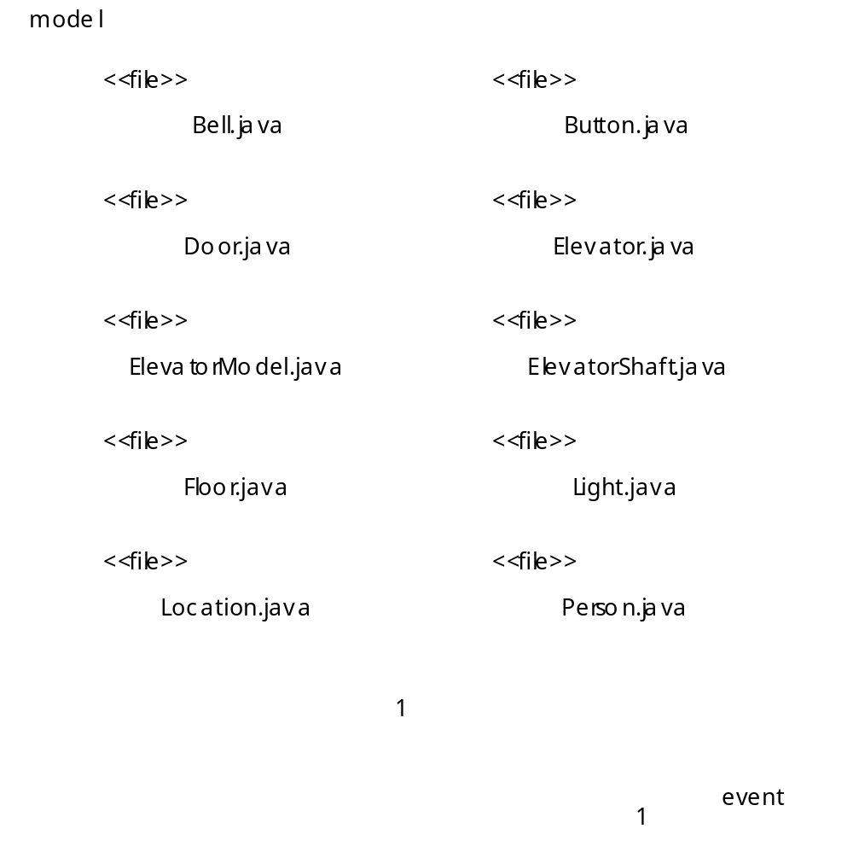
Fig. H.14 Component diagram for package model.

